Slide 1
Technology Entrepreneurship in Belt and Road Region: Telepresence Robots for COVID-19
Pradeep K. Ray
July 16th

Slide 2
Outline
Introduction for BRI
Systematic survey on Robot’s Application under COVID-19
Possible use scenarios for telepresence robots
Conclusion

Slide 3
Belt and Road Initiative (BRI)
mHealth for Belt and Road region (mHBR)
‘Robots for Elderly’ Project
Introduction

Slide 4
Introduction of BRI
China
BRR
Belt and Road Initiative
2/5 global gross
domestic product
2/3 World Population

Slide 5
Introduction of BRI
BRI
Why?
Increasing demand of technology innovations
A promising solution to boost the healthcare quality
A help for aging population challenged by pandemic like COVID-19
Entrepreneurship
Healthcare

Slide 6
Introduction of mHBR
What
A multi-country and multi-disciplinary initiative
How
Applications of mHealth technologies, such as smart phones, IoT, and robots
Who
The aged and disadvantaged population in developing countries

Slide 7
mHBR History
2018
2019
Launched at UM-SJTU JI in Shanghai, China
Had investigators from 14 countries along BRR
Discussed again in Entrepreneurship Week hosted by AIT, Bangkok
leading to an edited book ‘Mobile Technologies for Delivering Healthcare in Remote, Rural or Developing Regions’

Slide 8
mHBR Future
Global challenge by stakeholders of mHealth
Portable health clinic for primary healthcare in remote developing regions
Sustainable and resilient mHealth services for high availability in disasters
mHealth for the elderly considering applications from the perspective of the aging population
mHealth for chronic illnesses exploring the social impacts and cost-effective solutions
2020…

Slide 9
Challenge for the Elderly
80% death over 65
Death caused by COVID-19
Global proportion of the population over 65

Slide 10
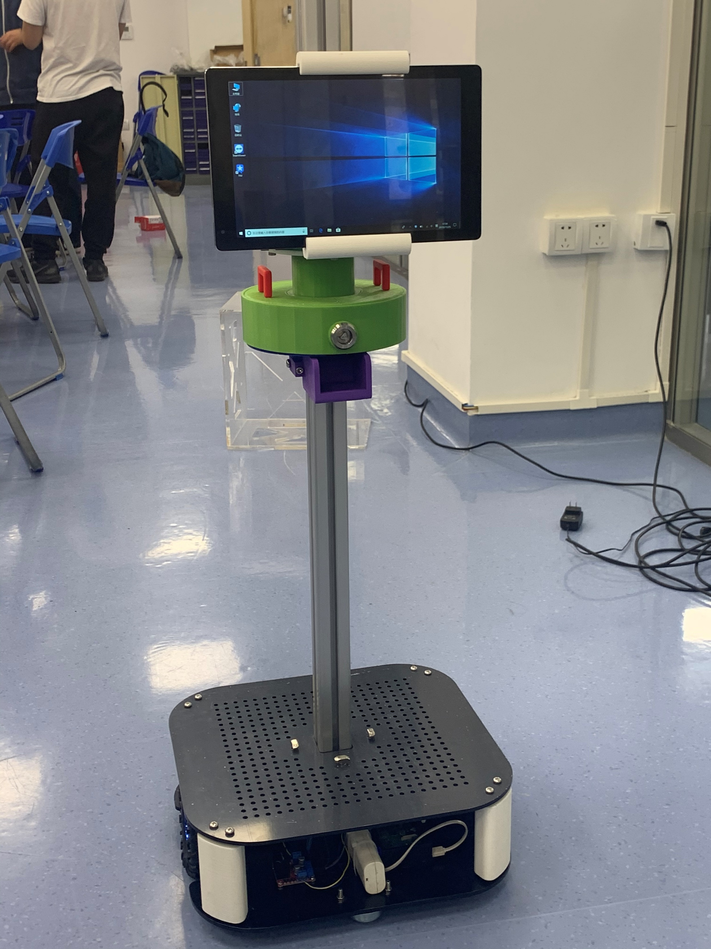
Robots for Elderly
Practical Telepresence Robot
Low lost for elderly
Applications for healthcare
management during pandemics

Slide 11
Overview and Methodology
Result Distribution Analysis
Robots’ applications in four major scenarios
Challenges faced by robots
Applications besides healthcare
Systematic Survey on
Robots in COVID-19

Slide 12
Overview
Robots’ role under pandemic
Avoid close contact between people
Work without human but sometimes higher efficiency
Save cost because don’t need protection

Slide 13
Methodology
PRISMA: Preferred Reporting Items for Systematic Reviews and Meta-Analyses
Keywords: robot AND (COVID OR pandemic OR quarantine OR teleconference OR epidemic OR telemedicine OR telepresence)
Nine Databases: CINAHL, ERIC, EMBASE, IEEE Xplore, MEDLINE, ProQuest Central, PubMed, PsycINFO, and Web of Science

Slide 14
Methodology
3946 articles identified through database searching
Identification
1006 duplicates removed
Screening
2940 articles screened
2828 articles excluded
112 full-text articles assessed for eligibility
50# of full-text articles excluded, with reasons
Eligibility
54# eligible articles
Included
61# of articles included in the analysis

Slide 15
Result Distribution
Among Databases
Among Continents

Slide 16
Result Distribution
Among Documentation Type
Among Application Scenarios

Slide 17
Applications under COVID-19
Hospital Robots
ICU Robots
Medicine delivery without close physical contact
Virtual meeting with patients, (A-8MO)
Control from frontline medical workers
Real-time and two-way supervision on multiple beds
Remote observation for vital signs, examine medical charts
Remote collaboration of a multidisciplinary team

Slide 18
Applications under COVID-19
Care robots with IoT
Public Use Robots
Connection to hospitals for remote diagnosis at home
Work as an intermediate station together with sensors, cell phones, TV
providing interpersonal communications for people in isolation
Efficient and safe ultraviolet light disinfection
Detect COVID-19 symptoms with sophisticated camera and contactless sensors
Measure multiple people’s temperature at same time

Slide 19
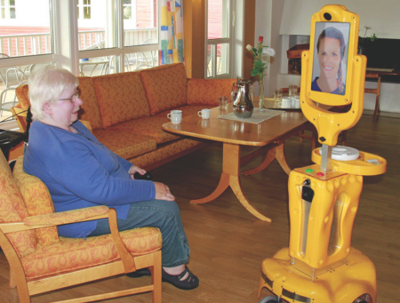
Challenges for Robots
Unstable signal transmission
Bad night performance
Lack of Trust
Voice Control
Limited Functions
Bulky Size
Transportation Function
Battery Life

Slide 20



Besides healthcare…
Meeting robots
Replicate similar user experience as face-to-face meetings
Enhance interactions between participants
Patrol robots
Transmit a real-time view of patrol to the management body
enhance the control in high-risk areas
Enforce quarantine policies
Shopping robots
Deliver the goods
Act as an agent of the owner to do physical shopping

Slide 21
Remote temperature monitoring
Remote consultation between health professionals and patients
Contactless delivery of food and medicines
Disinfect rooms with ultraviolet light and remove germs
Possible Scenarios
for Business Cases

Slide 22
Remote temperature monitoring
A dilemma for human:
Exposure to virus vs. temperature measurement
Showtime for robots:
Remote multiple measurements
Video guidance and monitoring
Access Control of doorways

Slide 23


Remote Consultation
Reservation System
Update schedule
Convenient Reservation
Through the Robot
Remote diagnosis
Simple Body Check
Automatic diagnosis
Doctors
Patients
Diagnosis System

Slide 24

Contactless delivery
In wards full of virus carriers, A robot can:
Deliver food as well as medicines
Save a lot of resources and money from protection
Improve user experience through video call
Measure patients’ temperature during delivery

Slide 25
Disinfection and Degerming
Safer
Users can stay outside and monitor the progress through the remote-control system
Faster
The robot can use stronger UV light or spray and automatic system to improve the efficiency

Slide 26
mHealth can help people in BRR a lot, especially in disasters like COVID-19
COVID-19 brought opportunities have a trial on large scale use of robots.
Revolution and development of practical robots for future is stimulated.
Limitations by keywords and years
Conclusion

Slide 27
Thank you
Q & A

